Slide 1
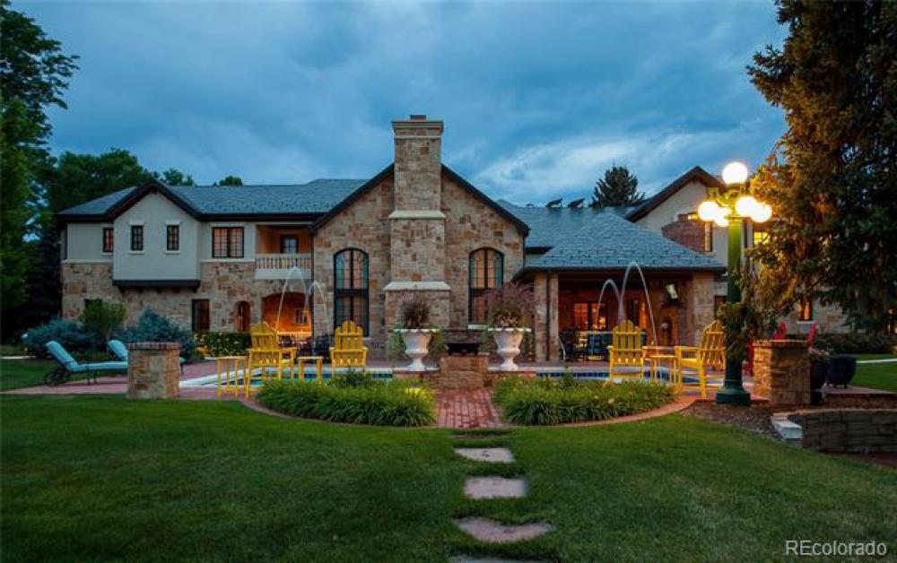
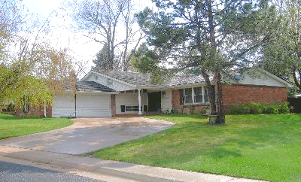
House market Colorado
BY: Alex Gonzalez

Slide 2
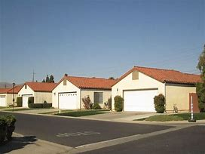
A little about this topic
I chose this since a new beginning of adulthood would be to look into buying my future family home after getting a job. Buying my dream house would be ideal and doing a project like this can help me understand a bit more about the house market.

Slide 3

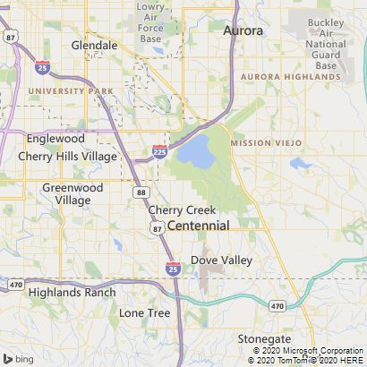
Data information
This data set was taken by the local real estate agencies in Englewood, Greenwood Village, Cherry Hills Village, and Centennial all in Colorado.
Involves correlation between square footage of property, bedrooms, bathrooms, year built, and city where it is located.
This study was conducted using the BoxCox transformation & Gamma regression.

Slide 4

Boxcox transformation

Slide 5
Programming in SAS:

Slide 6
Programming in R:

Slide 7
R outputs
Plotting a normality check histogram of the data we get a right skewed graph.
Since the p-value is less than 5% the data is not normal according to the Shapiro-Wilk test.

Slide 8
Output in R(cont..)
To make the data normalized I used the square root transformation.
Equation(transformed price) = 2(√y − 1)

Slide 9
Output in R(cont..)
Histogram of recommended transformation of the price with the new p-value and estimated coefficients.

Slide 10
Analysis of outputs
In the estimated coefficients we can see that the only significant predictor is the number of bathrooms at the 5% level.
From the deviance test conducted the p-value is relatively small hence the model fits the data well.

Slide 11
Interpretation & Prediction
The coefficient bathrooms is a numeric variable hence when it increases by one the transformed inverse price (in $10,000) would increase by 2.50819 units.
Prediction: 4000 square feet, 5 bedrooms, 3 bathrooms, year built is 2000.

Slide 12
Gamma regression

Slide 13
R programing

Slide 14
SAS Programming

Slide 15
R output
Estimated coefficients
Deviance test & prediction

Slide 16
Sas output

Slide 17
Analysis
Fitted model: E-hat(price) = exp(-5.6288+0.0177*sqft1K- 0.0473*bedrooms+ 0.2767*bathroms+ 0.0046*year)
Looking at the p-values for the estimated coefficients at a 5% level, the only significant predictor is bathroom as in the BoxCox transformation.
Dispersion parameter: α-hat= 1/5.9143 = 0.1690817
Checking the fit of the model for this regression with the deviance test we see that the model fits the data well due to the small p-value.

Slide 18
Interpretation & Prediction
Since the bathrooms is a numeric variable, as the number of bathrooms increases by one the price of the house would increase by (exp{0.2767}-1)*100%=9.
Prediction: sqft=4000, bedrooms=5, bathrooms=3, year=2000.
price0 = $10,000 * exp(-5.6288+0.0177*(4)- 0.0473*(5)+ 0.2767*(3)+ 0.0046*(2000)) = $696,031.3
SAS predicted price:

Slide 19
Comparing values & predictions
In this study the only significant predictor in the data when using both regressions was bathrooms at a 5% significant level as a numeric variable.
BoxCox prediction in SAS: $661,939.88
BoxCox prediction in R: $662,647.50
Gamma prediction by hand: $696,031.3
Gamma prediction in SAS: $697,241.15
Gamma prediction in R: $697,236.50

Slide 20

Conclusion
Throughout this project it was difficult for me to find something that related regression to the real life since there is so many examples but looking into housing, this project showed me on how a BoxCox Transformation & Gamma regression can be used to predict such things as prices for your future home
I’d like to thank all of you for listening to my presentation today and like to wish you & your families happy holidays!!!!

Slide 21

Thank you all

